Slide 1


Building Connected Cross Platform Apps with Xamarin and Azure
Allan Pead - @adpead - http://bit.ly/2mrVle6
Microsoft MVP, Xamarin Insider, Xamarin Premier Consultant Partner

Slide 2
Introduction to Xamarin

Slide 3









Complete mobile lifecycle solution
BUILD
TEST
MONITOR
ACCELERATE
One platform to build native apps for iOS and Android
Test any app on 2,000+ real devices in the cloud
Monitor performance and user behavior in live apps
Train your team and accelerate projects with deep expertise

Slide 4
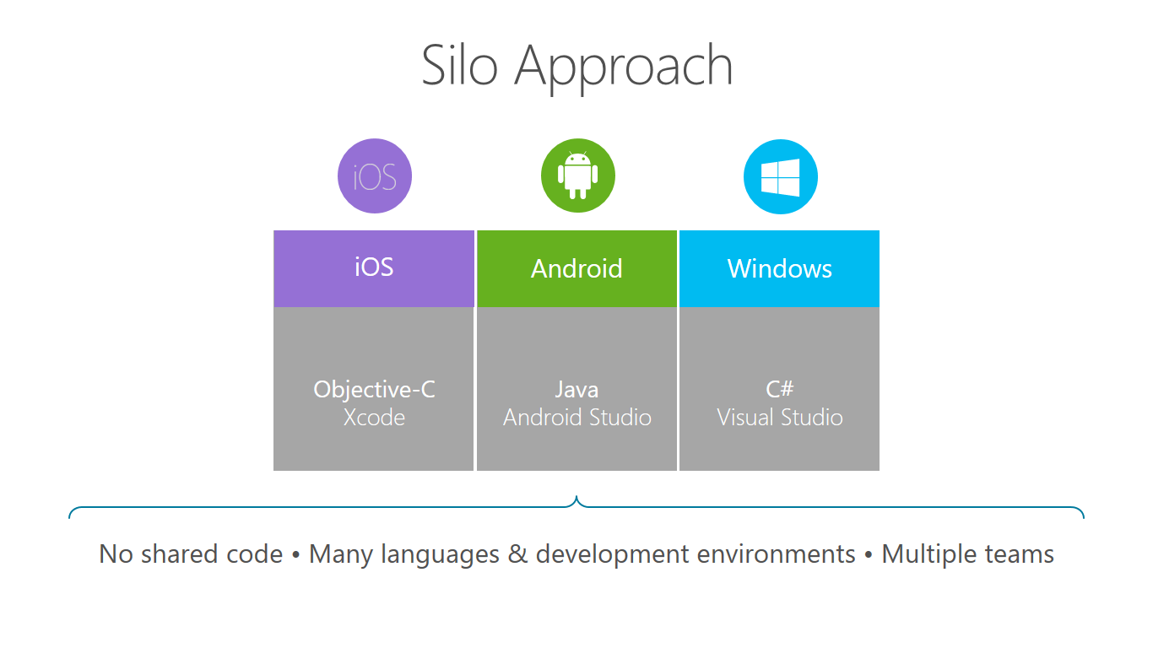

Slide 5
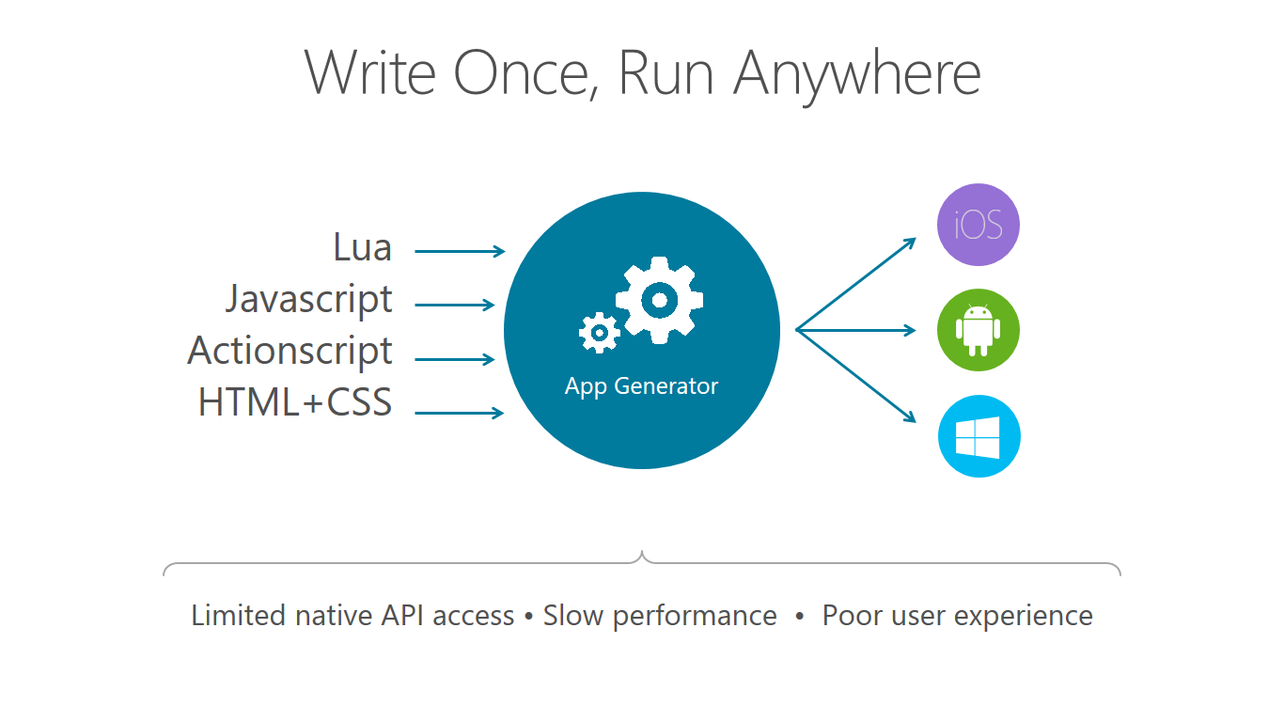

Slide 6
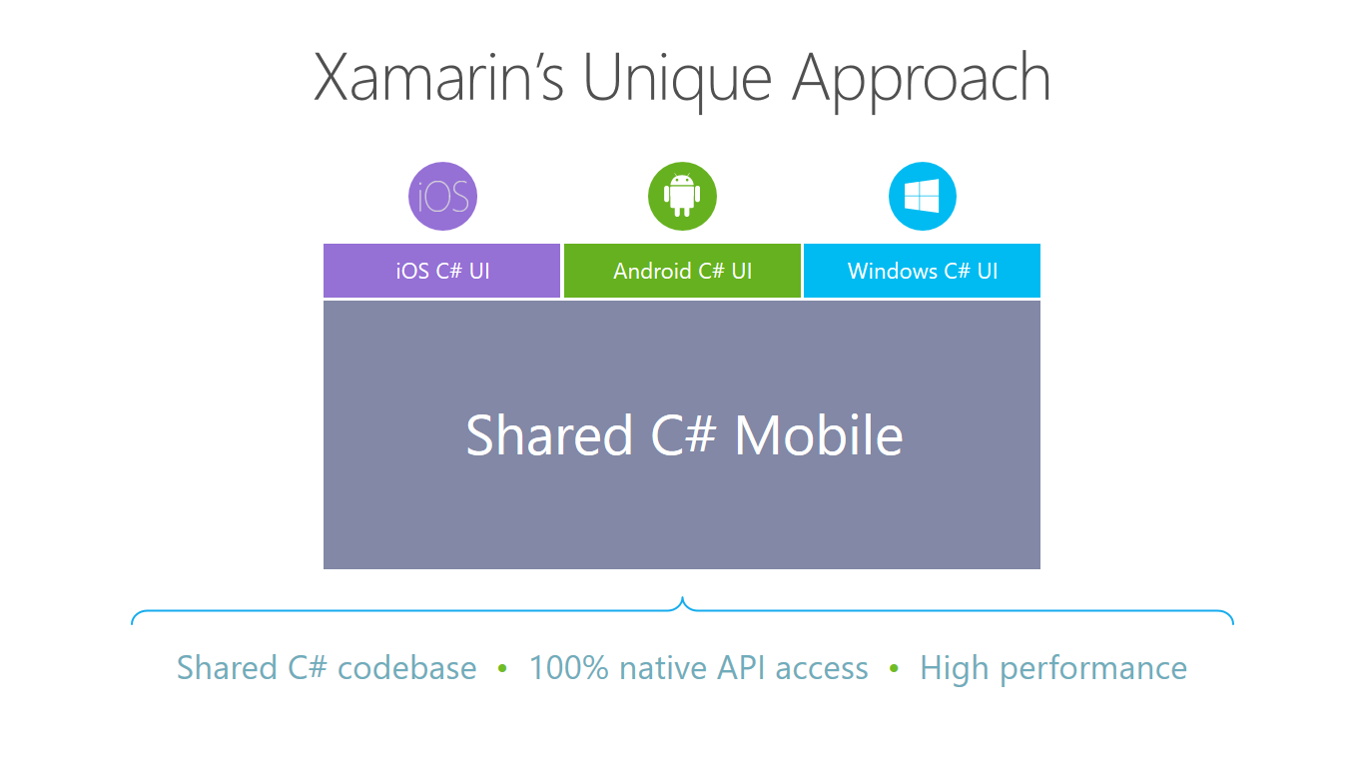

Slide 7
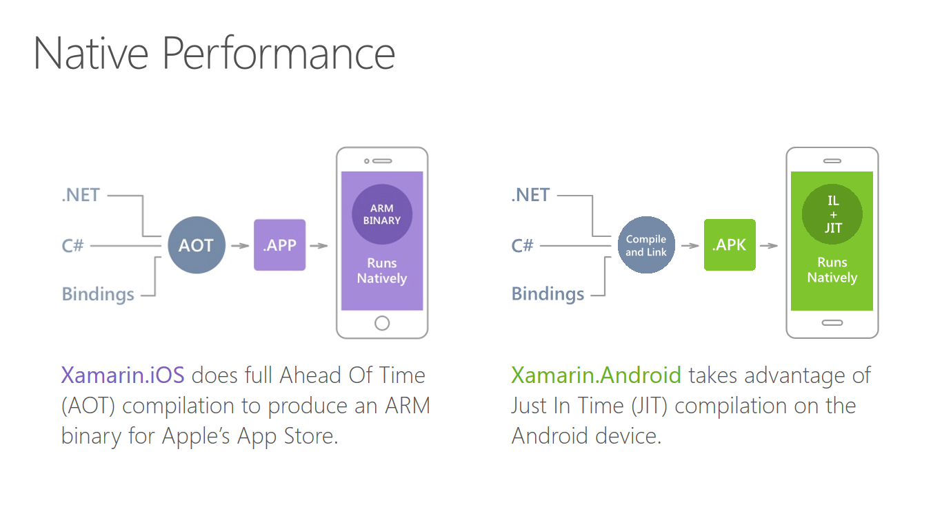

Slide 8
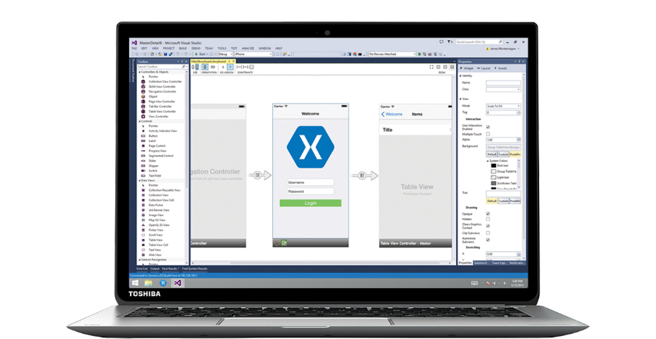
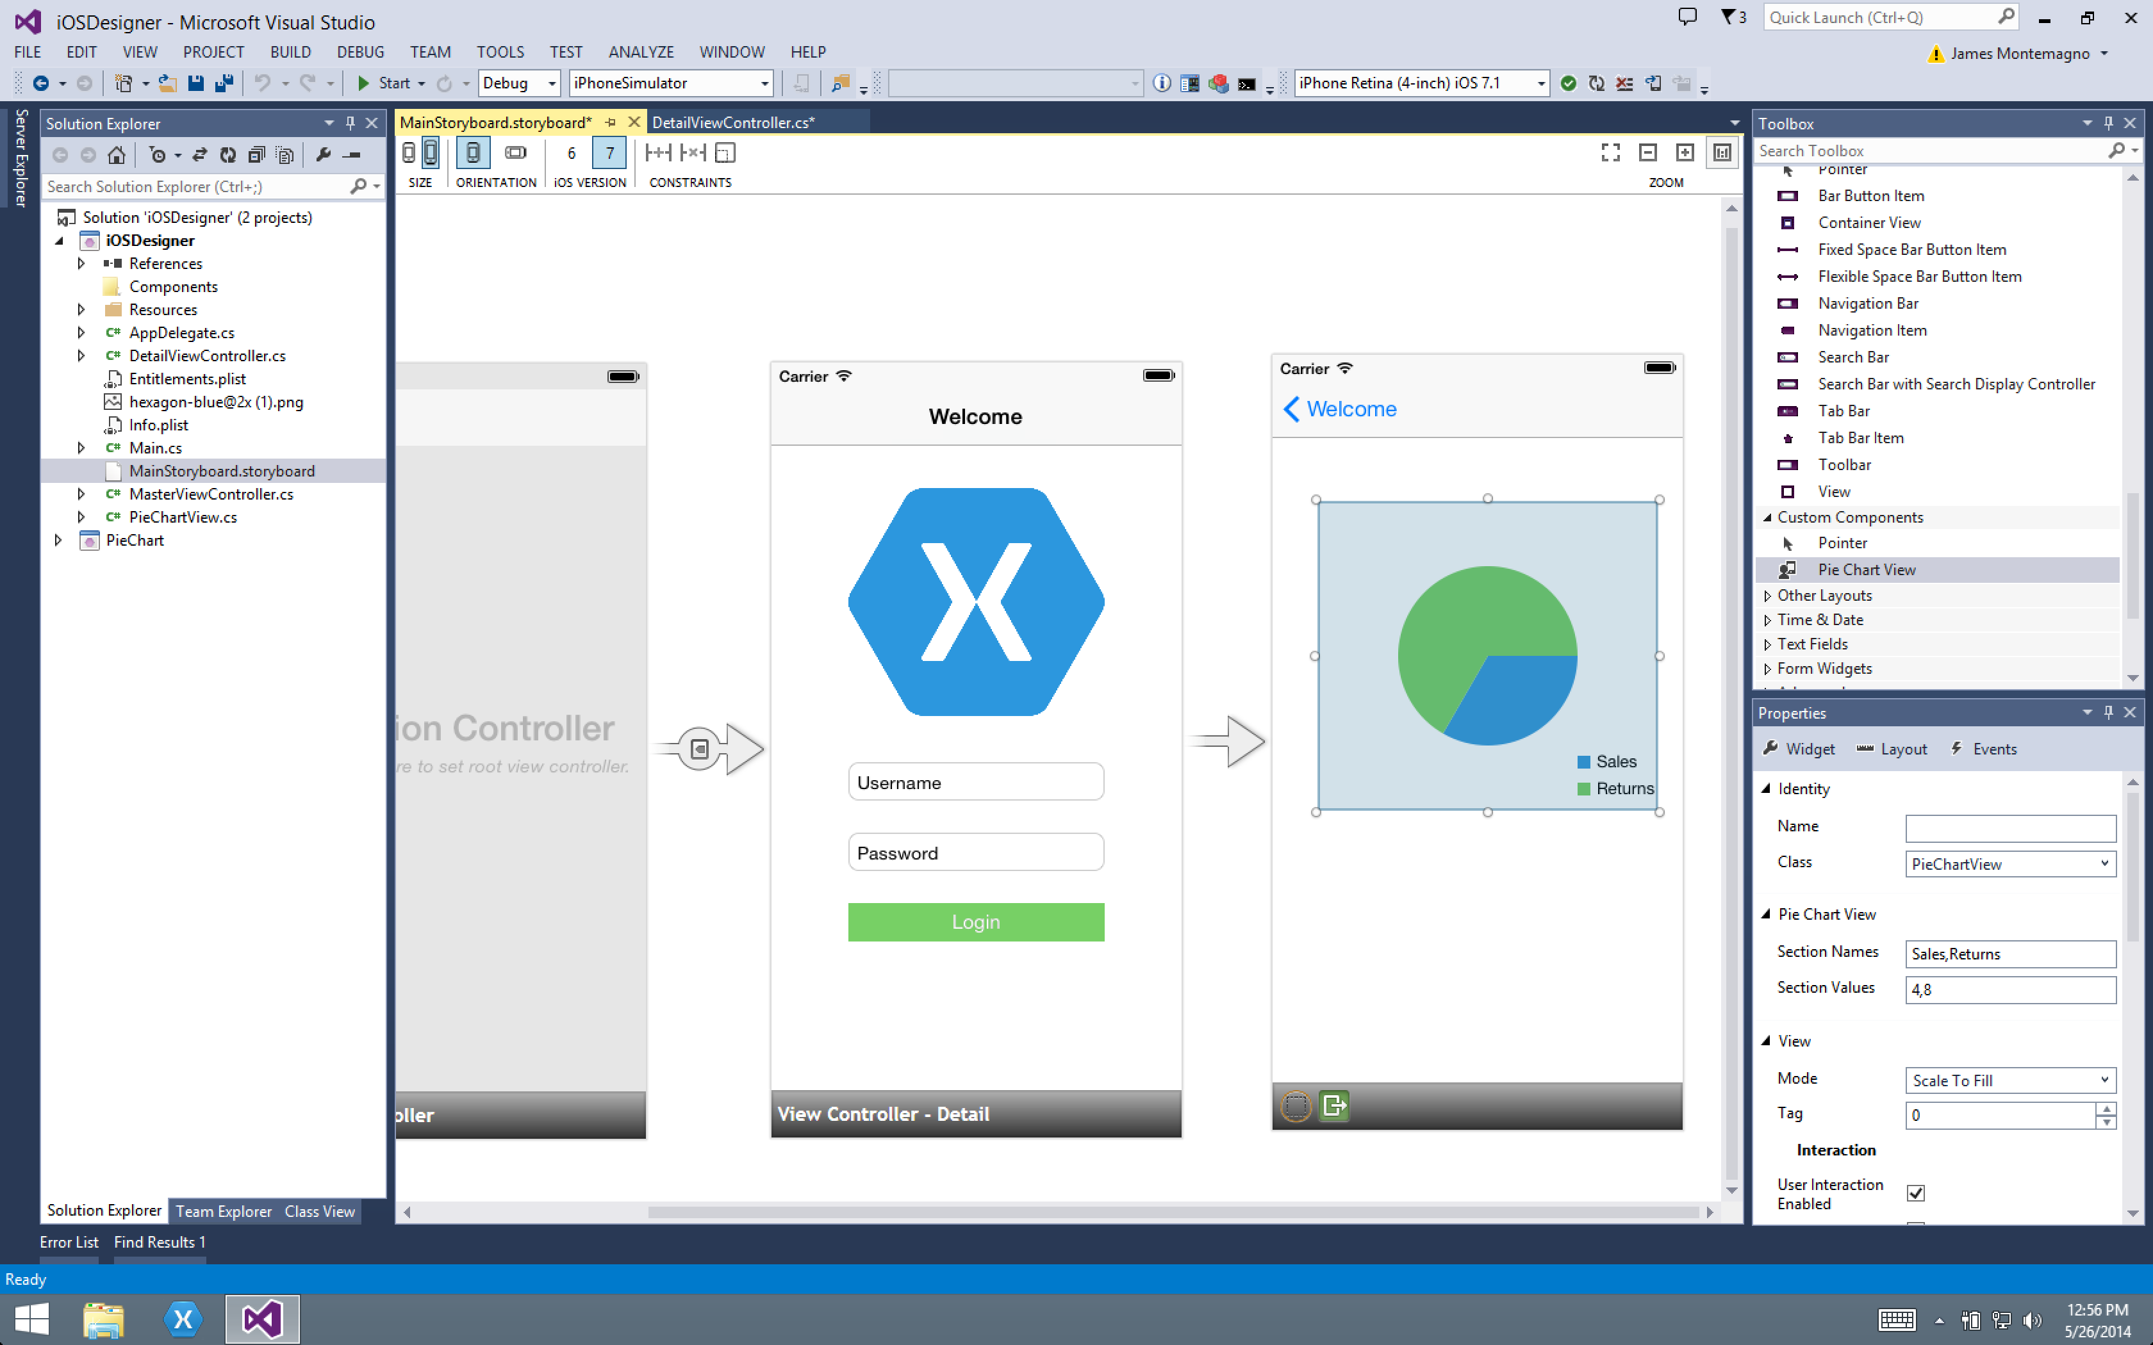
Xamarin for Visual Studio

Slide 9
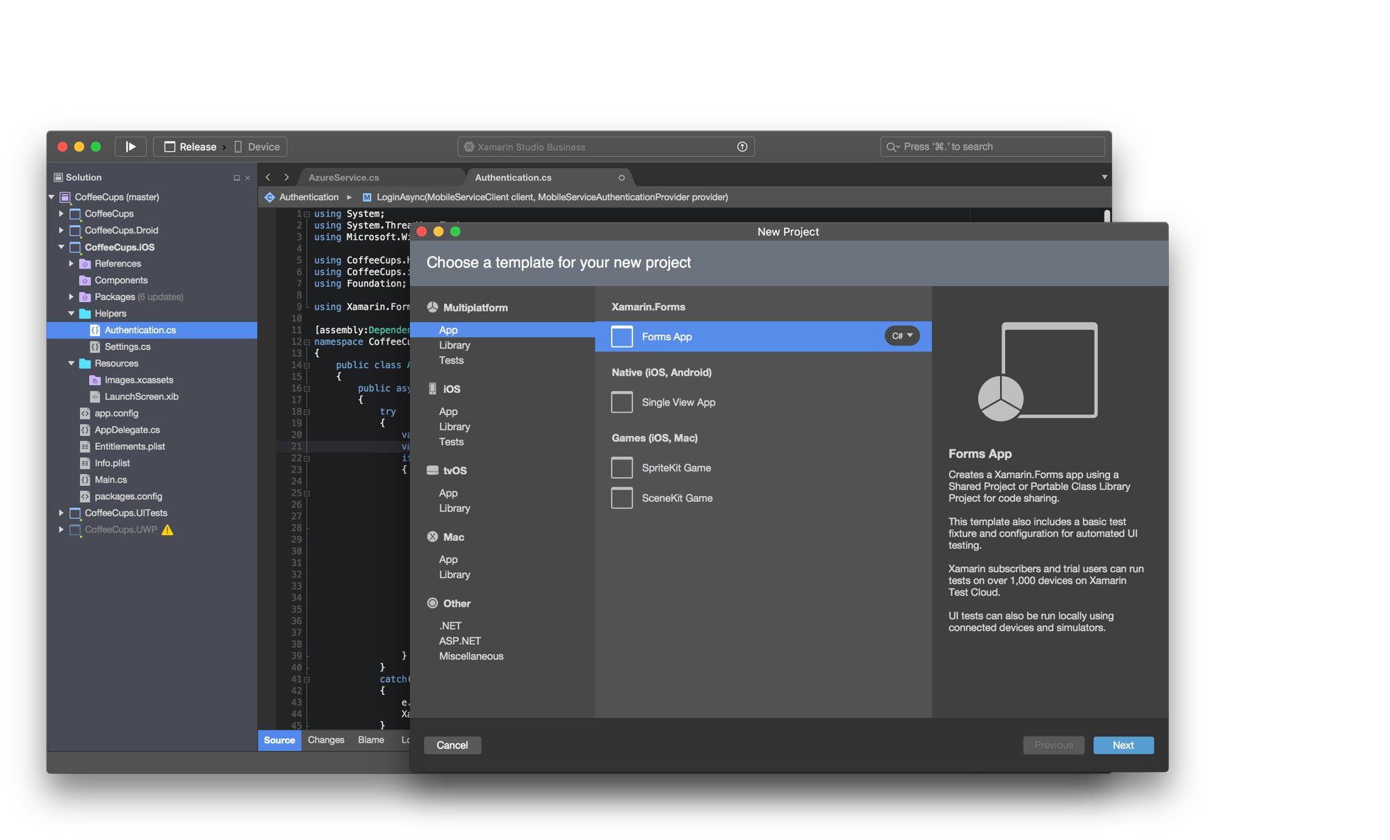
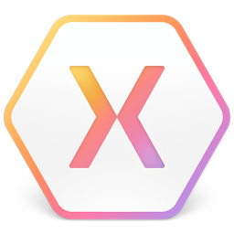
Xamarin Studio – Mac
Notes:
Xamarin Studio on Mac offers: Android, iOS and Mac development
World Class IDE with great features:
Code Analysis
Upload to Test Flight
Git & Subversion Integration
Code Completion
Code Navigation
Easy transition from Visual Studio
The same Solution & Projects open in BOTH Xamarin Studio and Visual Studio!

Slide 10

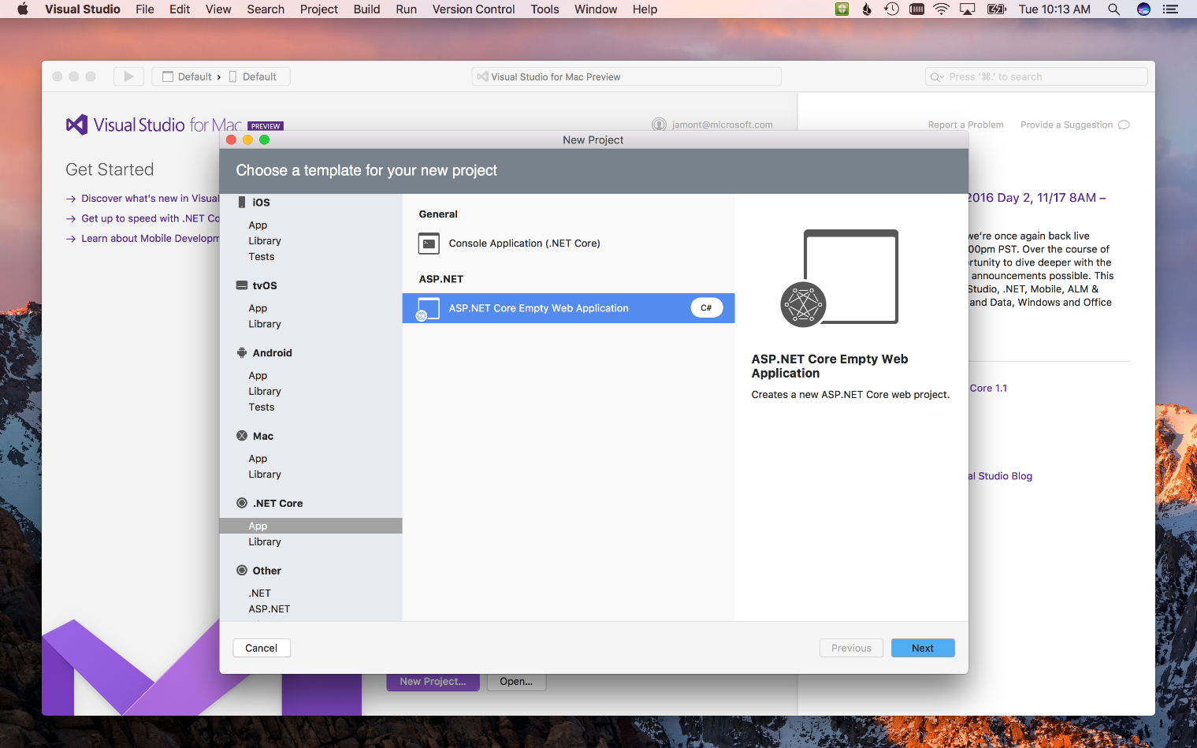
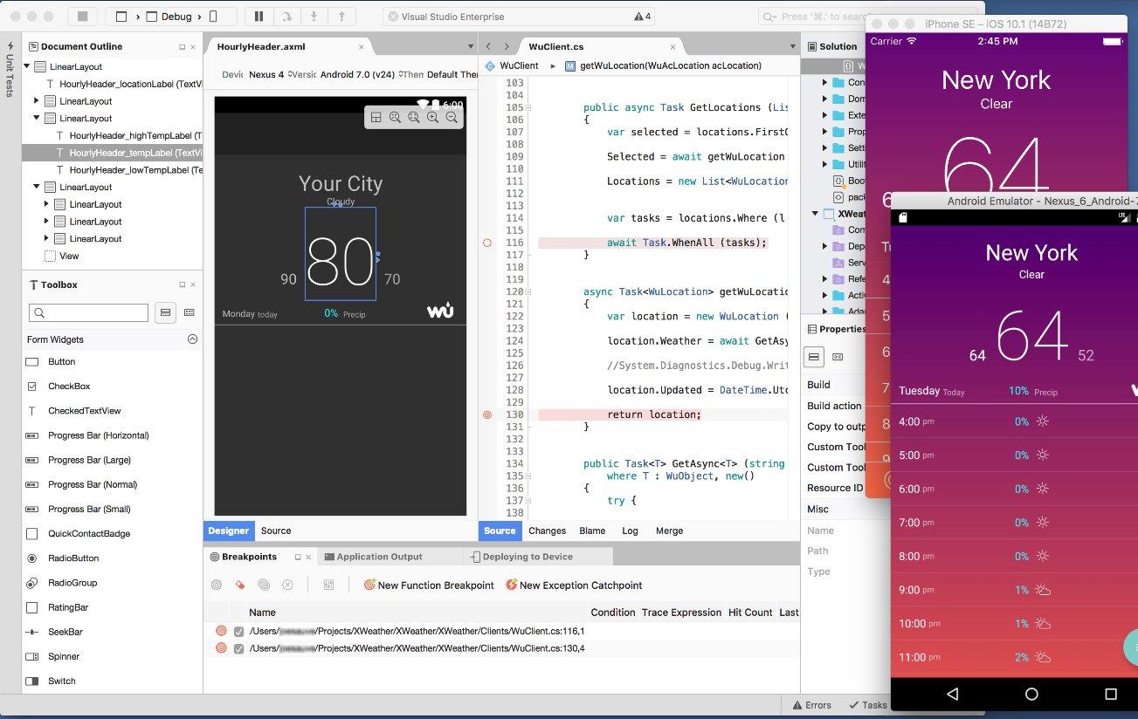
Visual Studio for Mac (Preview)
iOS, Android, & macOS
.NET development
.NET Core & ASP.NET Core
Tools for Azure
Notes:
The biggest surprise was the brand new Visual Studio for Mac!
In preview today and is the next evolution of Xamarin Studio.
Includes Azure Tools and .NET Core work loads. More in the future.

Slide 11
What is Xamarin Forms?

Slide 12
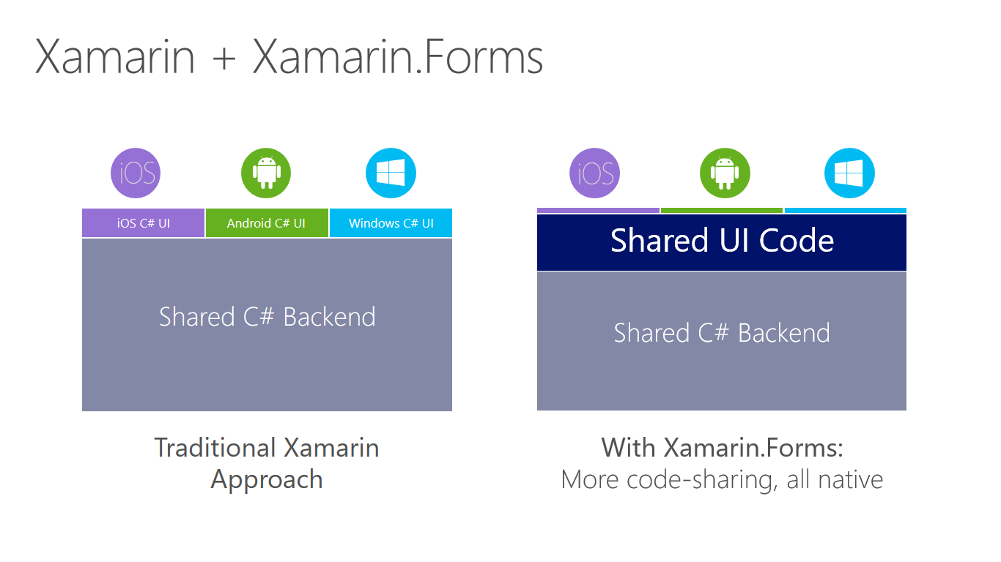

Slide 13
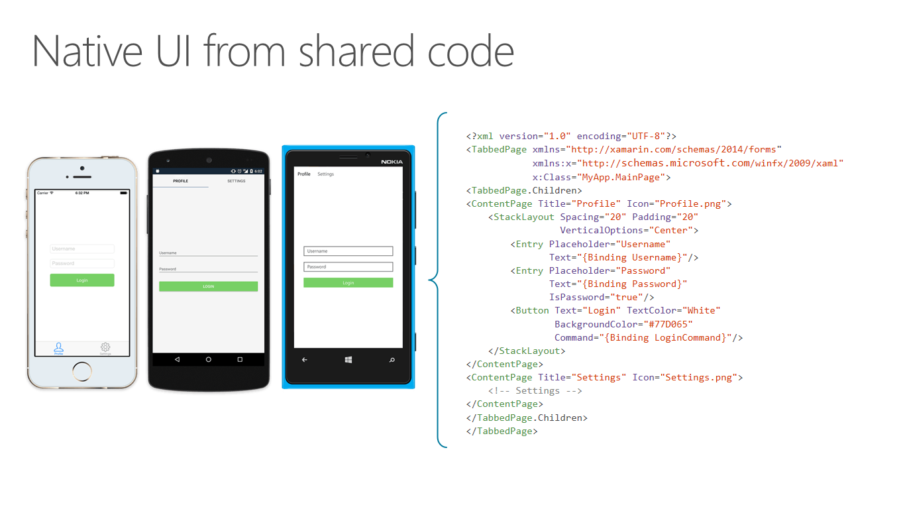

Slide 14
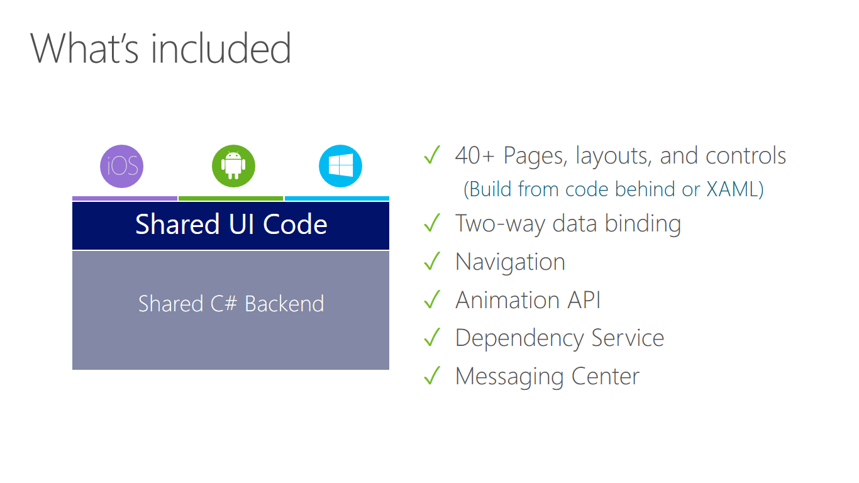

Slide 15
Azure Mobile Apps

Slide 16
Why Azure Mobile Apps?
Extremely powerful
Flexible
Easy Tables (Node.js Backend)
App Service (ASP.NET Backend)
Cross-platform client SDK
iOS, Android, and Windows
Open source C#
Backend and Client SDKS on GitHub
Notes:
Extremely powerful
You can do almost anything your backend would ever need to do with Azure. Data storage, authentication/authorization, push notifications, custom APIs, blob storage, etc.
Flexible
Need something lightweight? Azure is there.
Need something robust and powerful? Azure is there.
C# clients
I’m a frontend developer, I care a lot about how easy this makes MY job (selfish)
Many C# clients are written by Java developers, etc.
Easy to use C# client
Abstracts away much of pain of using a RESTful API
C# Features
Async / Await / TPL
Uses C# idioms
Properties, Fluent API
Seems obvious, but not always true (first class citizen)

Slide 17
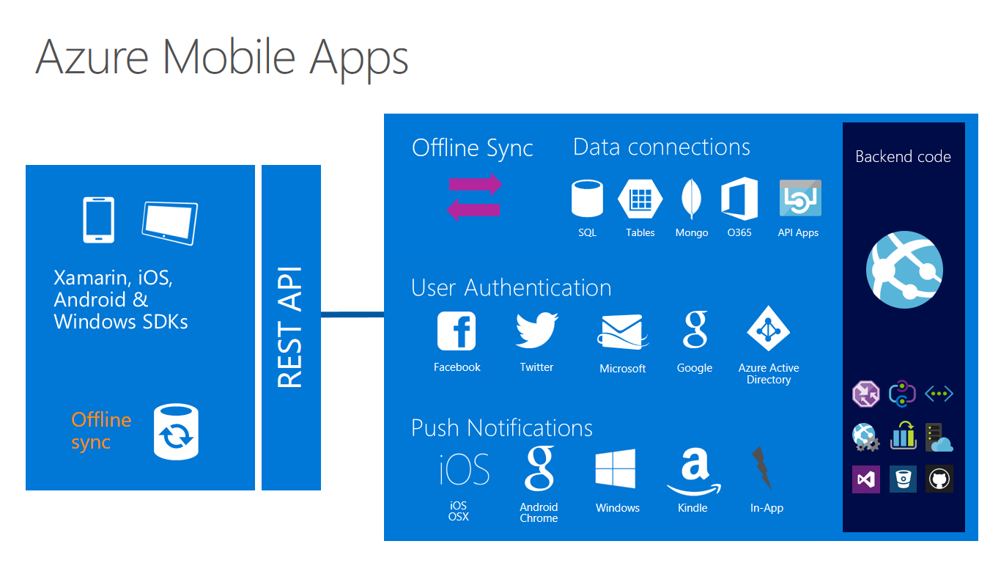

Slide 18
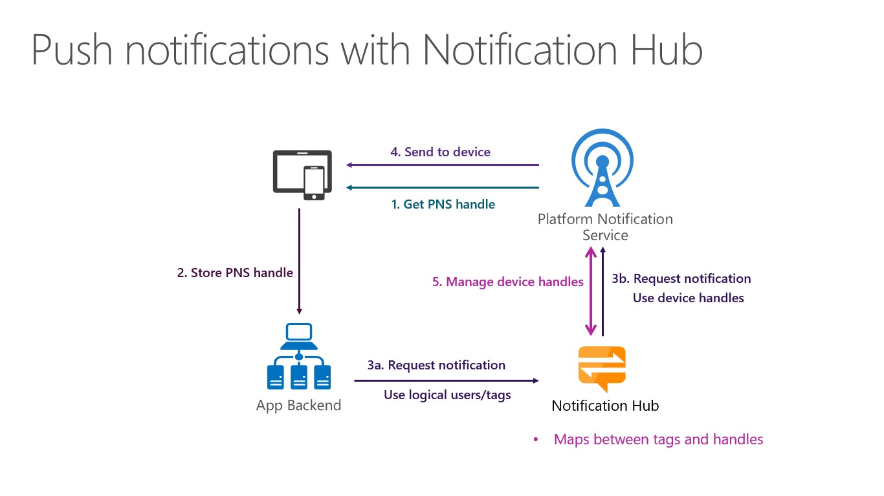

Slide 19
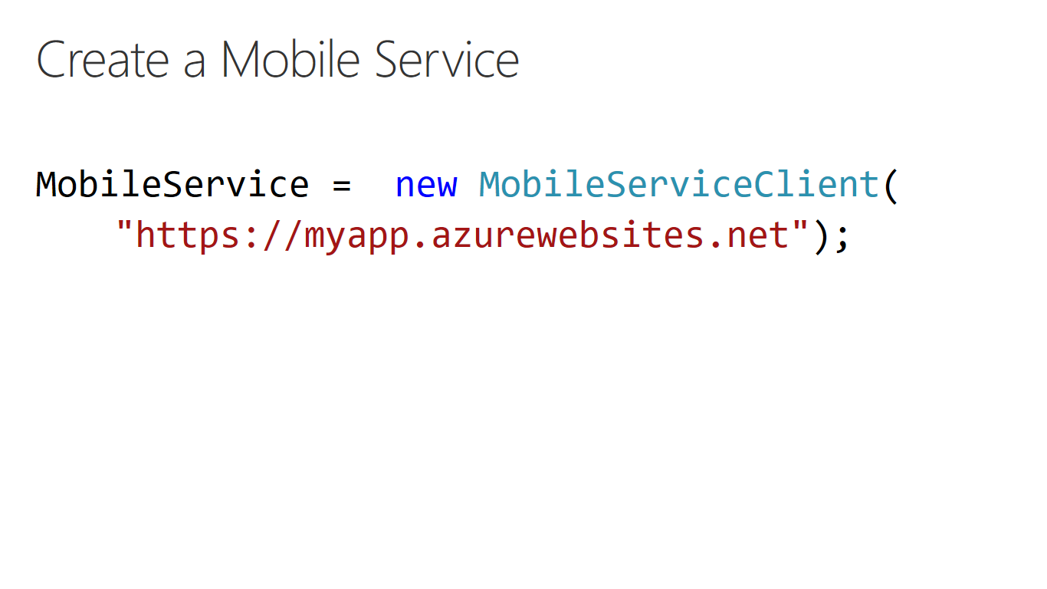

Slide 20
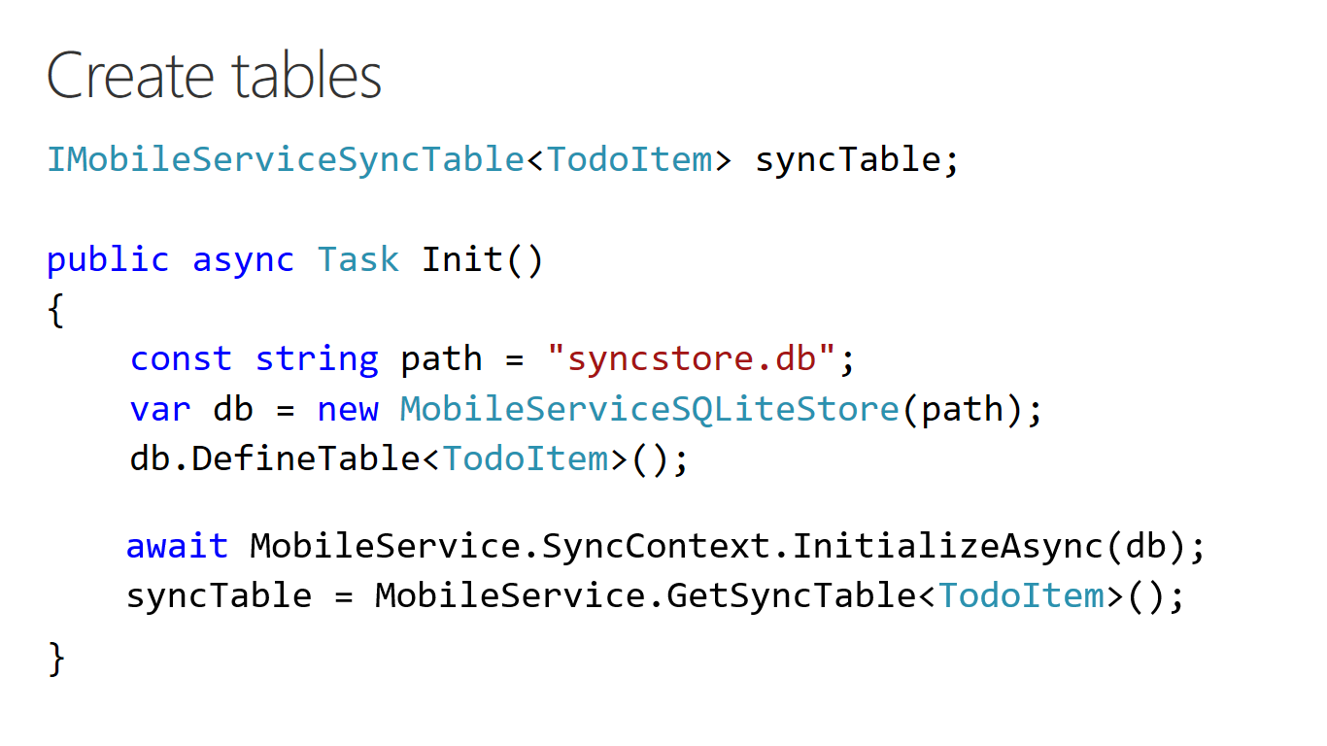

Slide 21
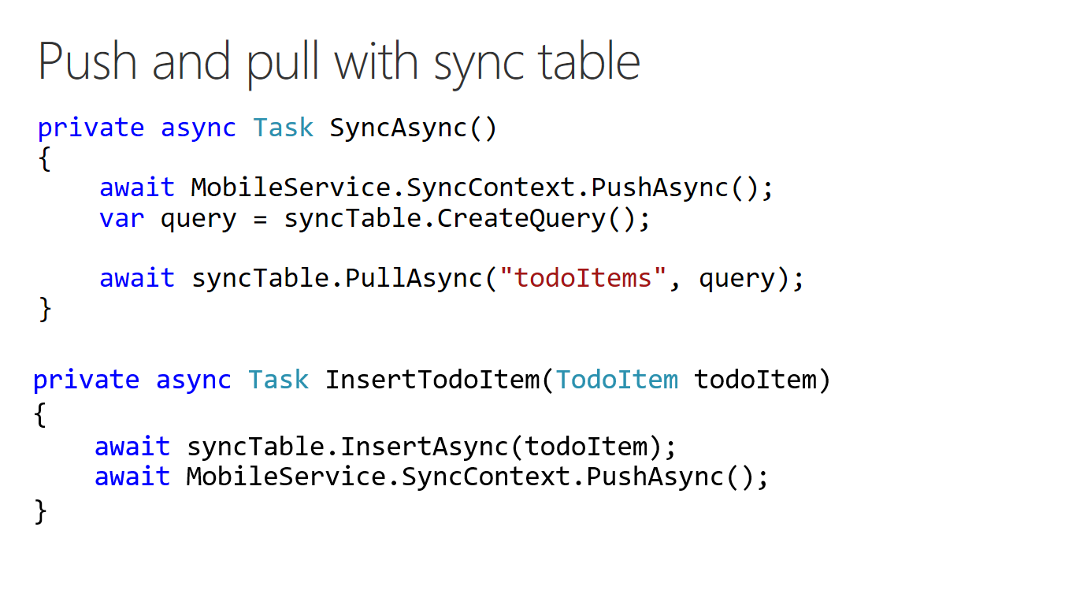

Slide 22
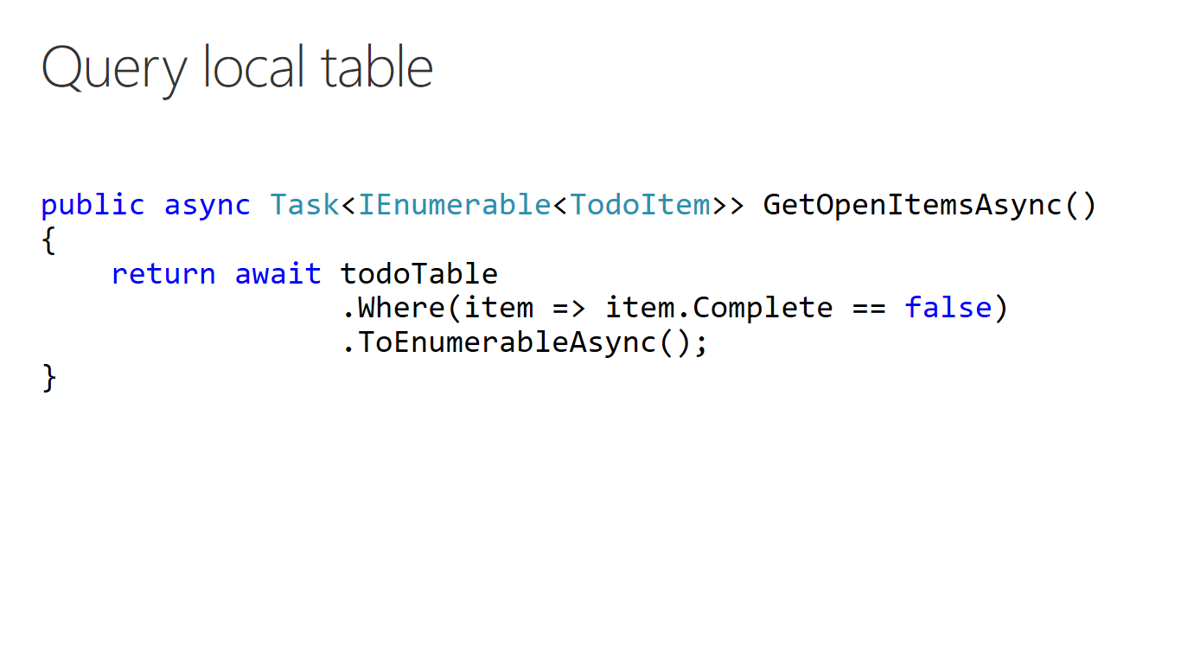

Slide 23
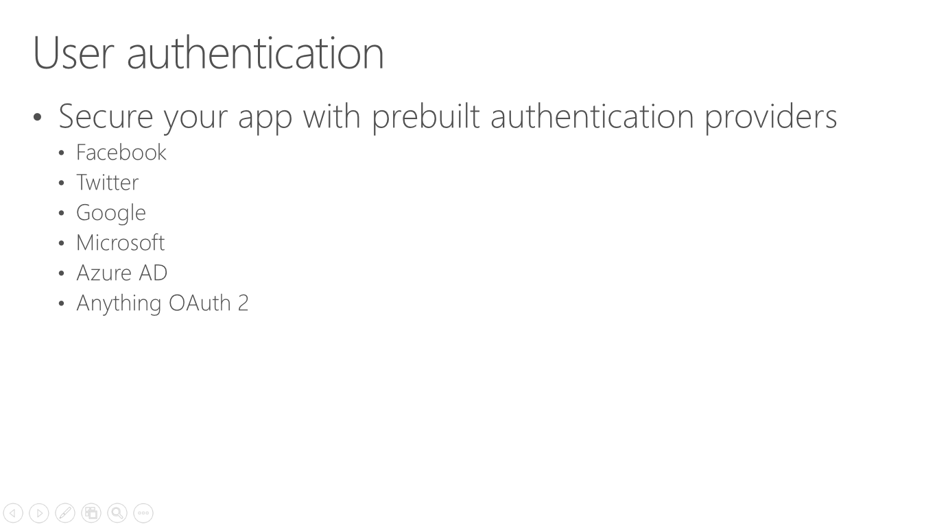

Slide 24
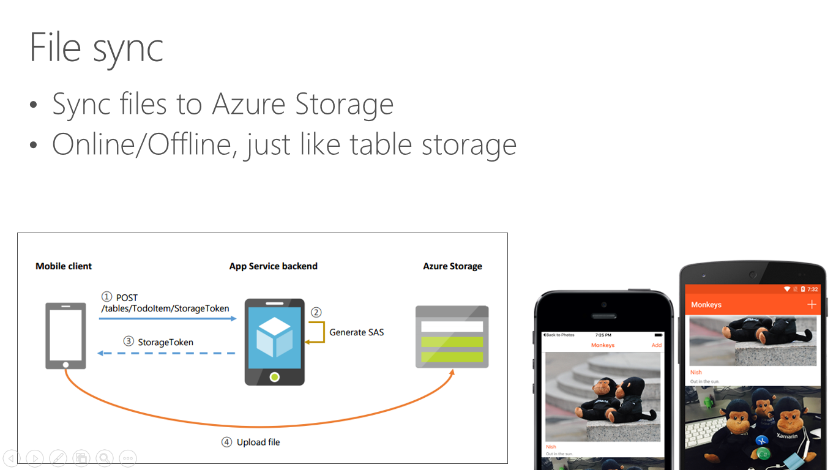

Slide 25
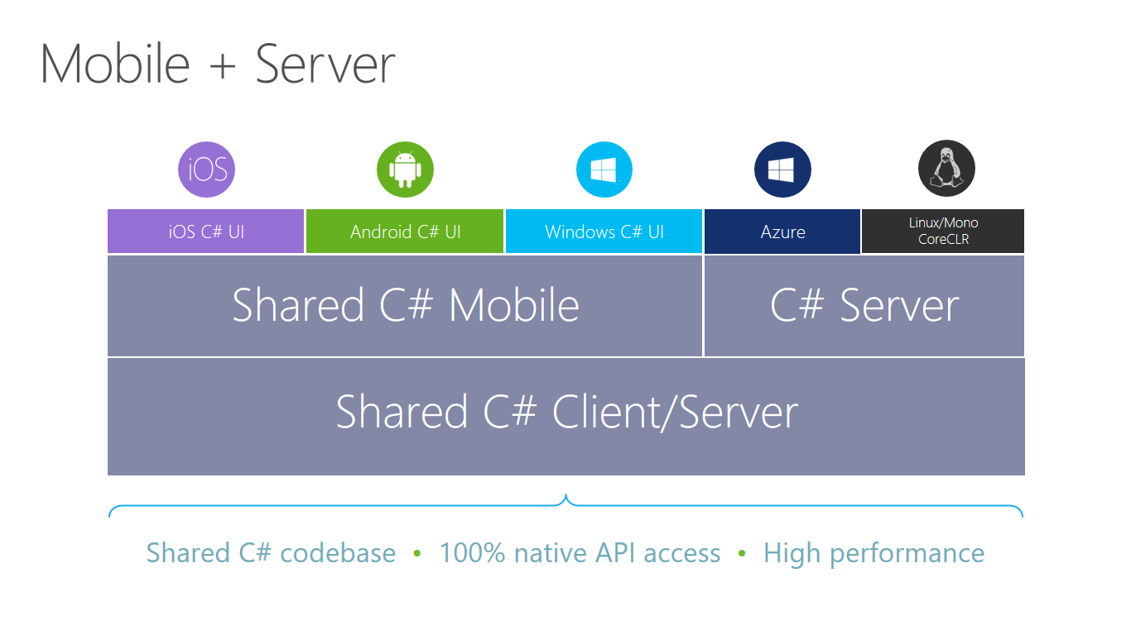

Slide 26
Thank you!
Download Now
https://www.xamarin.com/download
Xamarin and Azure
https://www.xamarin.com/azure
Xamarin Learning Resources
https://developer.xamarin.com/guides/
Xamarin University
https://www.xamarin.com/university
Learn and share with your local community
Xamarin User Groups
Cape Town (@CTXUG)
Johannesburg (@GXUGSA)
Durban (@DXUGSA)
Local Slack Community
https://zatech.slack.com #xamarin
My personal details
adpead@gmail.com
@adpead
http://www.explorationspace.co.za/

